Slide 1
Robust Regression

Slide 2
Linear regression assumes that…
The relationship between X and Y is linear
Y is distributed normally at each value of X
The variance of Y at every value of X is the same (homogeneity of variances)
Independent variable X are linearly independent
OR in short
X and Y are Independent and identically distributed (iid)
What if ordinary least squares assumption of constant variance in the errors is violated (which is called heteroscedasticity) ?

Slide 3
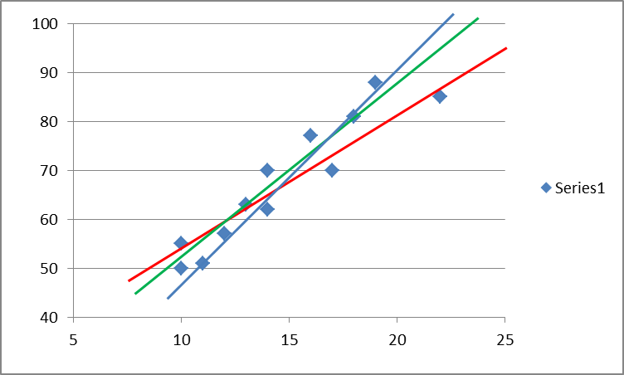
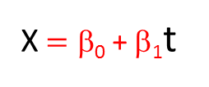
Let’s consider the case of linear regression, in which we have a set of n data values x_{j} j=1,2,...,n taken at times t_{j} =1,2,...,n, and we wish to fit a straight line to those data.
A straight line has the form
X $=\text{β}\text{0}$ + β₁t
β₀, is intercept and β1 is slope of the line.
Any possible choices for β0 and β1 define a straight line, but for most such choices the line is obviously not a good model of the data. So, how do we choose “good” values for the slope and intercept?
There is a sensible way — choose the line which gives the maximum likelihood of the observed data. We could even call this “maximum likelihood regression.” But now we have yet another problem: how do we compute the likelihood?

Slide 4

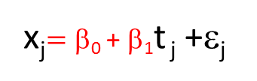

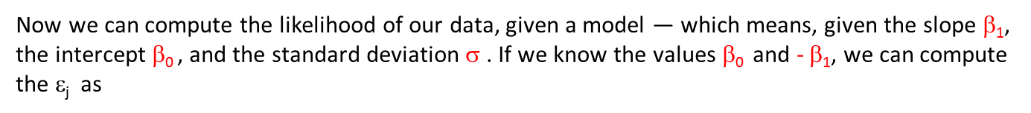
To do so, we have to have a model for the data, and that model must include the behavior of the noise, not just of the underlying signal.
Let’s start with the simplest (or at least, most natural) assumption about the data: that the data really do follow a straight line, with deviations which are zero-mean i.i.d. and follow the normal distribution. In this case our model is
x_{j}$=\text{β}\text{0}$ + β₁t _{j} +ε_{j}
where ε_{j} is a normally distributed random variable.
Now we can compute the likelihood of our data, given a model — which means, given the slope β₁, the intercept $\text{}\text{0}$, and the standard deviation σ . If we know the values $\text{}\text{0}$ and - β₁, we can compute the ε_{j} as
ε_{j} $=\text{x}\text{j}$-$\text{}\text{0}$ - β₁t _{j}
These values are called the residuals for our model, and if our model is correct then they’re equal to the true noise values.
$\text{F}\text{(}\text{ε}\text{j}\text{ )}=\frac{e^{−\frac{\text{ε}\text{j}2}{2\text{σ}2} }}{\text{σ}\sqrt{2π}}$
The probability density for any particular ε_{j} value is

Slide 5


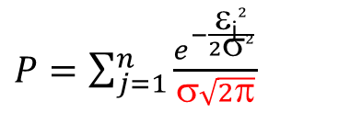
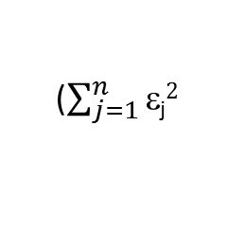

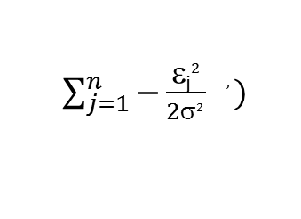
The joint probability for all the noise values, often called the likelihood function is
$P=\sum_{j=1}^{n}{\frac{e^{−\frac{\text{ε}\text{j}2}{2\text{σ}2} }}{\text{σ}\sqrt{2π}}}$
The maximum-likelihood solution is that which gives the maximum probability.
It’s generally easier to work with the log-likelihood, which is just
$☹=\sum_{j=1}^{n}{[−\frac{\text{ε}\text{j}2}{2\text{σ}2} −\text{ln}\text{(σ) -} \text{1/2 }\text{ln}\text{(}2π\text{) ]}}$
If we need to find the values of $\text{}\text{0}$ and β₁ s.t. they maximize the quantity
$\sum_{j=1}^{n}{−\frac{\text{ε}\text{j}2}{2\text{σ}2 } , })$
max (
max (
$$\frac{\text{-}\text{ε}\text{j}2}{2\text{σ}2 }),$$
$$\text{} \text{Being} \text{constant}$$
($\sum_{j=1}^{n}{\text{ε}\text{j}2}$
min
)
So the solution for the slope and intercept is that which minimizes the sum of squares of the residuals — hence the name “least squares.” Therefore the least-squares solution is the maximum-likelihood solution when the given assumptions hold true.

Slide 6
When the data violate the given assumptions, OLS is not the maximum-likelihood solution.
What assumptions might be violated?
Noise may not be independent
Normal Distribution may not hold good. (Outliers)
In such a case it is often useful to compute a statistic which is
resistant to the presence of outliers. For the average, for instance, there is
such a statistic called the median.
There are also methods for linear regression which are resistant to the presence of outliers, which fall into the category of robust regression.
Probably the most common is to find the solution which minimizes the sum of the absolute values of the residuals rather than the sum of their squares. This is the method of least absolute deviations.
It is highly resistant to outliers (as long as there aren’t many of them), and in fact the median is the least-absolute-deviation estimate of the center of a distribution (whereas the mean is the least-squared deviation estimate).

Slide 7
Such a strategy can be generalized by choosing some other function than the square or the absolute value, for which we will minimize its sum over all values of the residuals.
Such functions are called M-estimators.
M-estimators need not actually represent the log-likelihood function, although that was the originating idea and is why they’re called “M”-estimators.
In fact both the square and the absolute value can be used as M-estimators, so this broad class includes both least-squares and least-absolute-deviation regression, although when least-squares is selected is doesn’t accomplish the usual purpose — to be resistant to outliers !

Slide 8




OLS Regression- Linear Regression
In a linear regression model the response variable is a linear function of the regressors:
where β is a p×1 vector of unknown parameters; ε_{i}'s are unobserved scalar random variables (errors) which account for the discrepancy between the actually observed responses y_{i} and the "predicted outcomes" x_{i}^{T}β;
This model can also be written in matrix notation as
where y and ε are n×1 vectors, and X is an n×p matrix of regressors, which is also sometimes called the design matrix.
The matrix is called the Moore–Penrose pseudoinverse matrix of X.

Slide 9

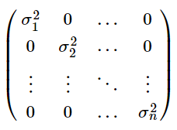


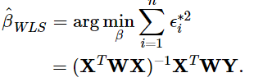
The model under consideration is
where now ϵ is assumed to be (multivariate) normally distributed with mean vector 0 and nonconstant variance-covariance matrix
If we define the reciprocal of each variance, as the weight, then let matrix W be a diagonal matrix containing these weights:
The weighted least squares estimate is then
Since each weight is inversely proportional to the error variance, it reflects the information in that observation. So, an observation with small error variance has a large weight since it contains relatively more information than an observation with large error variance (small weight).
The weights have to be known (or more usually estimated) up to a proportionality constant.

Slide 10
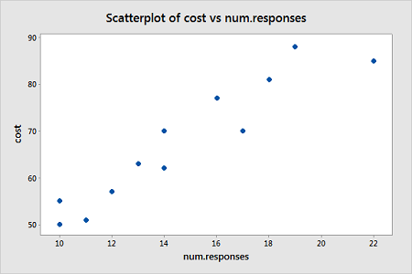
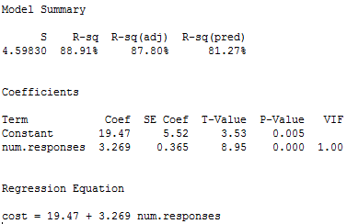
Example 1: Computer-Assisted Learning Dataset
Data is outcome of the study of computer-assisted learning by n = 12 students.
The response is the cost of the computer time (Y) and the predictor is the total number of responses in completing a lesson (X).
i | Responses | Cost
1 | 16 | 77
2 | 14 | 70
3 | 22 | 85
4 | 10 | 50
5 | 14 | 62
6 | 17 | 70
7 | 10 | 55
8 | 13 | 63
9 | 19 | 88
10 | 12 | 57
11 | 18 | 81
12 | 11 | 51

Slide 11
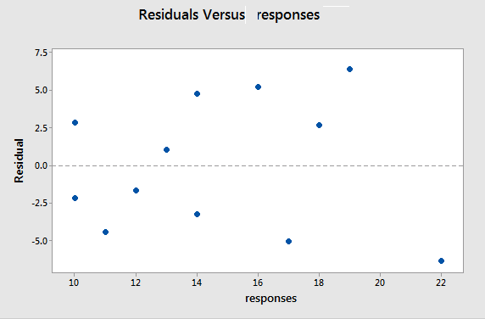
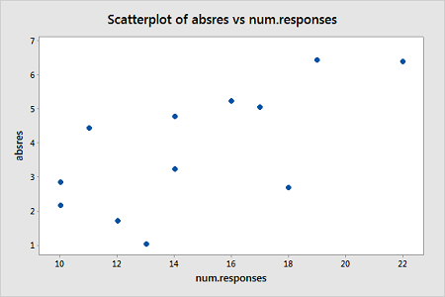
A plot of the residuals versus the predictor values indicates : "megaphone" pattern”
We will turn to weighted least squares to address this possibility.
The weights we will use will be based on regressing the absolute residuals versus the predictor.
The weights we will use will be based on regressing the absolute residuals versus the predictor.
weights would be defined as 1 over the squared fitted values.

Slide 12
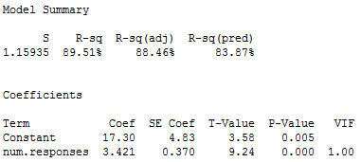
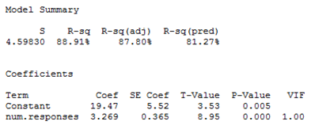
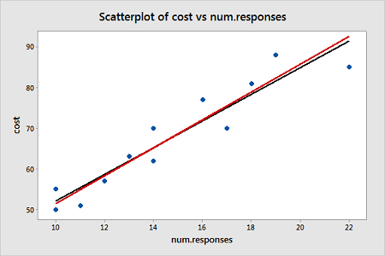
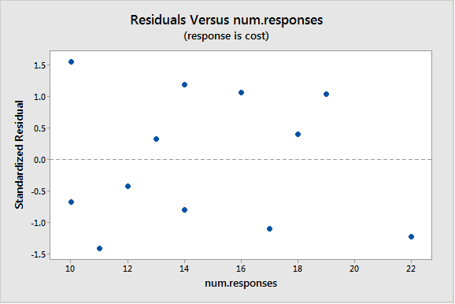
The summary of this weighted least squares fit
The summary of this OLS fit
Plot
With weighted least squares, it is crucial that we use studentized residuals to evaluate the aptness of the model,
of OLS fitted line (black) and WLS fitted line (red)

Slide 13
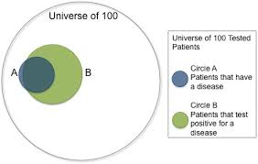
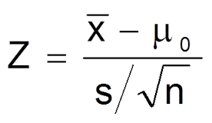
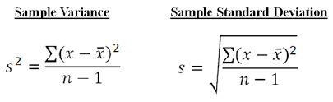


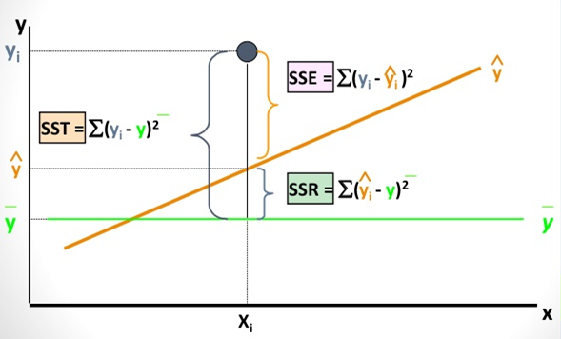
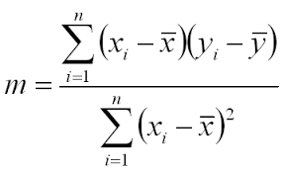
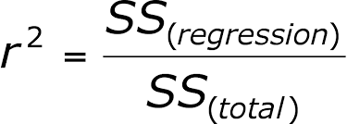
S is sample std dev
The relationship between X and Y is linear,
Y is distributed normally at each value of X,
The variance of Y at every value of X is the same (homogeneity of variances),
Independent variable X are linearly independent, OR in short X and Y are Independent and identically distributed (iid)

Slide 14
Ridge Regression : L2 Regularization
min(Least Square Objectfun)+ α(Sum of square Coeff)
Coefficient never reach ZERO for higher values of α
Includes all features in Model , Used to prevent OVERFITTING
Lasso Regression : L1 Regularization
min(Least Square Objectfun)+ α(absolute value of magnitude of Coeff)
Coefficient can be ZERO for higher values of α
Feature selection as some feature coefficient could be zero
STEPWISE regression is cumbersome for high Dimensional data
Elastic net combines both Ridge and Lasso

Slide 15
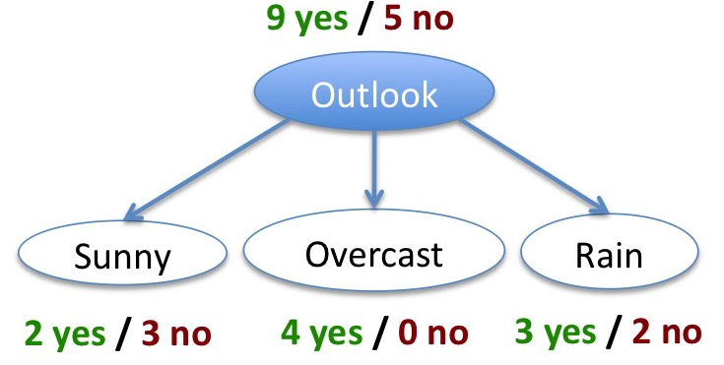
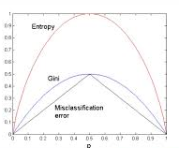
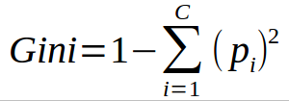

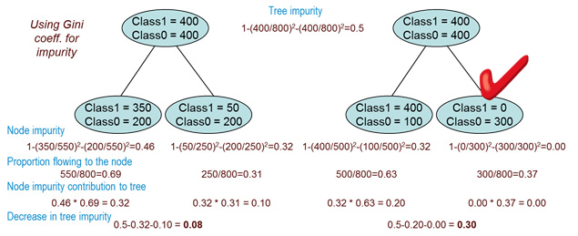
Variable importance in RF : The general idea is to permute the values of each feature and measure how much the permutation decreases the accuracy of the model. Clearly, for unimportant variables, the permutation should have little to no effect on model accuracy, while permuting important variables should significantly decrease it.

Slide 16
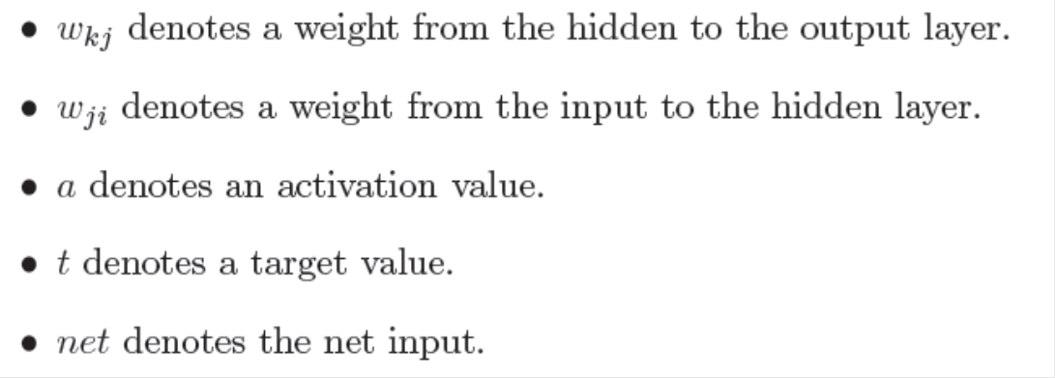
Gradient Descent Error
Total Error
Lets begin at the output layer with a particular weight.
However error is not directly a function of a weight. We expand this as follows.
Let’s consider each of these partial derivatives in turn. Note that only one term of the E summation will have a non-zero derivative: the one associated with the particular weight we are considering.

Slide 17
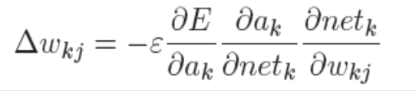

Weight change rule for a hidden to output weight
Derivative of the error with respect to the activation
Derivative of the net input with respect to a weight
Note that only one term of the net summation will have a non-zero derivative: again the one associated with the particular weight we are considering.
Derivative of the activation with respect to the net input
Now as
Weight change rule for a hidden to output weight
we can rewrite the result of the partial derivative as:
Change in weight is proportional to error at K multiplied by activation j. ie
Change in weight is proportional to error at (L+1)th layer multiplied by activation at Lth Layer.
Where a_{k} =

Slide 18

Weight change rule for an input to hidden weight
Now to determine the appropriate weight change for an input to hidden weight. This is more complicated because it depends on the error at all of the nodes this weighted connection can lead to.
Change in weight is proportional to error at (L+1)th layer multiplied by activation at Lth Layer.
For Change in weight form j to i
Error Propagated from K to J multiplied by rate of change of activation at j w r t net and weight
Error propagated from layer k to j is
The rate of change of activation at j wrt net and weight

